Slide 1
Chapter 2 Data Transmission
2.1 Parallel and Serial Transmission
2.2 Line Configuration, Synchronous/Asynchronous Communication
2.3 Bit Rate/ Baud rate, Transmission Channel, RS-232C and RS- 449 Interface Standards

Slide 2
Data Transmission
Data transmission refers to the movement of data in form of bits between two or more digital devices.
This transfer of data takes place via some form of transmission media (e.g. coaxial cable, fiber optics etc.)
Notes:
The most widely used codes that have been adopted for this function are the Extended Binary Coded Decimal (EBCDIC) and the American Standard Code for Information Interchange codes (ASCII). Both coding schemes cater to all the normal alphabetic, numeric, and punctuation characters, collectively referred to as printable characters and a range of additional control characters, known as non-printable characters.
To represent all characters of the keyboard, a unique pattern of 7 or 8 bits in size is used. The use of 7 bits means that 128 different elements can be represented, while 8 bits can represent 256 elements

Slide 3
Types of Data Transmission
Data Transmission
Serial
Synchronous
Asynchronous
Parallel

Slide 4
Parallel Transmission
In parallel transmission, all the bits of data are transmitted simultaneously on separate communication lines.
In order to transmit n bits, n wires or lines are used. Thus each bit has its own line.
All n bits of one group are transmitted with each clock pulse from one device to another i.e. multiple bits are sent with each clock pulse.
Parallel transmission is used for short distance communication.
As shown in the fig, eight separate wires are used to transmit 8 bit data from sender to receiver.

Slide 5
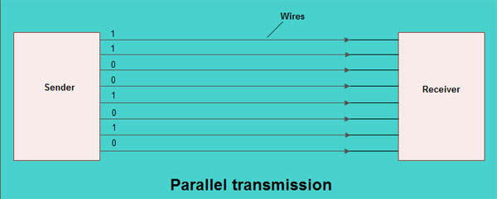
Advantage of parallel transmission
It is speedy way of transmitting data as multiple bits are transmitted simultaneously with a single clock pulse.
Disadvantage of parallel transmission
It is costly method of data transmission as it requires n lines to transmit n bits at the same time.

Slide 6
Serial Transmission
Definition: When transferring data between two physically separate devices, especially if the separation is more than a few kilometers, for reasons of cost, it is more economical to use a single pair of lines. Data is transmitted as a single bit at a time using a fixed time interval for each bit. This mode of transmission is known as bit-serial transmission.
In serial transmission, the various bits of data are transmitted serially one after the other.
It requires only one communication line rather than n lines to transmit data from sender to receiver.
Thus all the bits of data are transmitted on single line in serial fashion.
In serial transmission, only single bit is sent with each clock pulse.

Slide 7
As shown in fig., suppose an 8-bit data 11001010 is to be sent from source to destination. Then least significant bit (LSB) i.e. 0 will be transmitted first followed by other bits. The most significant bit (MSB) i.e. 1 will be transmitted in the end via single communication line.
The internal circuitry of computer transmits data in parallel fashion. So in order to change this parallel data into serial data, conversion devices are used.
These conversion devices convert the parallel data into serial data at the sender side so that it can be transmitted over single line.
On receiver side, serial data received is again converted to parallel form so that the interval circuitry of computer can accept it

Slide 8
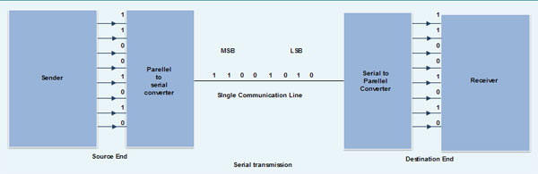

Slide 9
Advantage of Serial transmission
Use of single communication line reduces the transmission line cost by the factor of n as compared to parallel transmission.
Disadvantages of Serial transmission
Use of conversion devices at source and destination end may lead to increase in overall transmission cost.
This method is slower as compared to parallel transmission as bits are transmitted serially one after the other.

Slide 10
Types of Serial Transmission
There are two types of serial transmission-synchronous and asynchronous both these transmissions use 'Bit synchronization’
Bit Synchronization is a function that is required to determine when the beginning and end of the data transmission occurs.
Bit synchronization helps the receiving computer to know when data begin and end during a transmission. Therefore bit synchronization provides timing control.

Slide 11
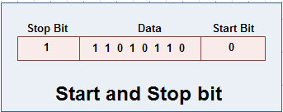
Asynchronous Transmission
It sends only one character at a time . Character is either a letter of alphabet/number/control character. I.e. it sends one byte at a time.
Bit synchronization between two devices is made possible using start bit and stop bit.
Start bit indicates the beginning of data i.e. alerts the receiver to arrival of new group bits. A start bit usually 0 is added to the beginning of each byte.
Stop bit indicates the end of data i.e. to let the receiver know that byte is finished, one or more additional bits are appended to the end of the byte. These bits, usually 1s are called stop bits.

Slide 12
Addition of start and stop increase the number of data bits. Hence more bandwidth is consumed in asynchronous transmission.
There is idle time between the transmissions of different data bytes. This idle time is also known as Gap
The gap or idle time can be of varying intervals. This mechanism is called Asynchronous, because at byte level sender and receiver need not to be synchronized. But within each byte, receiver must be synchronized with the incoming bit stream.

Slide 13
Advantages of Asynchronous transmission
This method of data transmission is cheaper in cost as compared to synchronous e.g. If lines are short, asynchronous transmission is better, because line cost would be low and idle time will not be expensive.
In this approach each individual character is complete in itself, therefore if character is corrupted during transmission, its successor and predecessor character will not be affected.
It is possible to transmit signals from sources having different bit rates.
The transmission can start as soon as data byte to be transmitted becomes available.
Moreover, this mode of data transmission in easy to implement.

Slide 14
Disadvantages of asynchronous transmission
This method is less efficient and slower than synchronous transmission due to the overhead of extra bits and insertion of gaps into bit stream.
Successful transmission inevitably depends on the recognition of the start bits. These bits can be missed or corrupted.
Application
Best Suited for Internet traffic in which information is transmitted for short bursts.
Asynchronous transmission is well suited for keyboard type-terminals and paper tape devices.

Slide 15
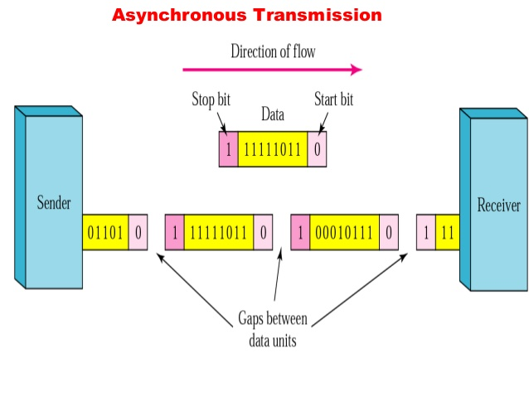

Slide 16
Synchronous Transmission
Synchronous transmission does not use start and stop bits.
In this method bit stream is combined into longer frames that may contain multiple bytes.
There is no gap between the various bytes in the data stream.
In the absence of start & stop bits, bit synchronization is established between sender & receiver by 'timing' the transmission of each bit.
Since the various bytes are placed on the link without any gap, it is the responsibility of receiver to separate the bit stream into bytes so as to reconstruct the original information.
In order to receive the data error free, the receiver and sender operates at the same clock frequency.

Slide 17
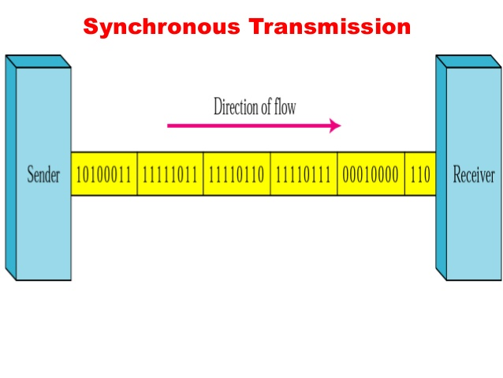

Slide 18
Advantage of Synchronous transmission
This method is faster as compared to asynchronous as there are no extra bits (start bit & stop bit) and also there is no gap between the individual data bytes.
Disadvantages of Synchronous transmission
It is costly as compared to asynchronous method. It requires local buffer storage at the two ends of line to assemble blocks and it also requires accurately synchronized clocks at both ends. This lead to increase in the cost.
The sender and receiver have to operate at the same clock frequency. This requires proper synchronization which makes the system complicated.

Slide 19
Application of Synchronous transmission
Synchronous transmission is used for high speed communication between computers.
Assignment- Difference between Synchronous and Asynchronous transmission?

Slide 20
Line Configuration
The way two or more communication devices attached to a link.
Line configuration is also referred to as connection.
A Link is the physical communication pathway that transfers data from one device to another.
There are two possible line configurations. 1. Point-to-Point. 2. Multipoint.

Slide 21
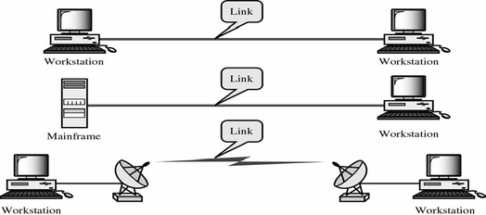
Point to point

Slide 22
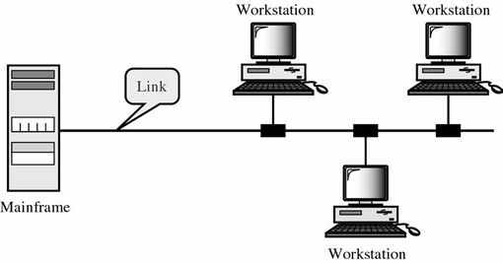
Multipoint Configuration

Slide 23
Also known as multidrop line configuration
One or more than two specific devices share a single link capacity of the channel is shared.
There are two possibilities in a multipoint line config
Spatial Sharing: If several devices can share the link simultaneously
Temporal (Time) Sharing: If users must take turns using the link , then its called Temporally shared or Time Shared Line Configuration

Slide 24
Signal Rate: The signal rate is the numbers of signal elements sent in 1 second. The unit is baud.
The data rate is sometimes called the bit rate: the signal rate is sometimes called the pulse rate, the modulation rate, or the baud rate.

Slide 25
Transmission Channel
Transmission channels are generally referred to as the communication channels and these act as the links, which help in the transmission of the data from one device in a particular network to the other.
A transmission channel has the ability to make use of the various types of the media like the following –
1. Physical connection lines –
a. Twisted pair of the copper wires. b. Coaxial cables. c. Optical fiber.
2. Micro – wave lines –
a. ‘Line of sight’ earth micro wave (from tower to the tower) b. Radio/wire – less transmission waves (AM/FM) c. Satellite

Slide 26
Features Of The Communication Channels
Transmission Speed: Also called as the Baud Rate and it refers to the total amount of the information which can be transmitted through any type of the telecommunication channel. Transmission speed can be measured in terms of the Bits per Second.
Band – width: The capacity of the communications channel as measured by the difference between the highest and the lowest frequencies that can be transmitted by that channel is referred to as the band – width.
Transmission Modes: The various modes affecting the transmission may involve the Asynchronous Transmission and the Synchronous Transmission. In asynchronous transmission, transmission of only one character takes place at a time and this type of the process is generally used for the low speed transmission but in case of the synchronous transmission, a group of the characters is transmitted simultaneously and is often used for the high speed transmission of the block of the characters.

Slide 27
Transmission Direction: The transmission of the data can take place in the different directions with the help of the simplex, the half duplex or the full duplex transmission.
Communication Processors: Transmission of the data and then the reception in a telecommunication network can be done with the help of the certain processors, some examples of the processors can be summarized as the follows –
a. Front End Processors b. Concentrator c. Controller d. Multiplexer e. Telecommunication Software

Slide 28
Transmission Modes
The term Transmission Mode defines the direction of the flow of information between two communication devices i.e. it tells the direction of signal flow between the two devices.
Transmission Modes
Simplex
Half Duplex
Full Duplex
Types of Transmission Mode

Slide 29
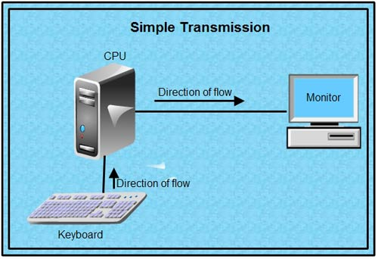
Simplex
Communication can take place in one direction connected to such a circuit are either a send only or receive only device.
TV broadcasting is an example. Simplex transmission generally involves dedicated circuits. Simplex circuits are analogous to escalators, doorbells, fire alarms and security systems:

Slide 30
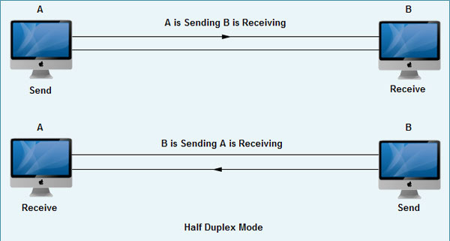
Half Duplex
A half duplex system can transmit data in both directions, but only in one direction at a time that mean half duplex modes support two-way traffic but in only one direction at a time.
For example walkie-talkie

Slide 31
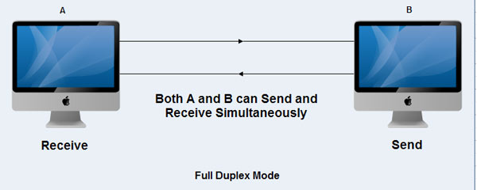
Full Duplex
A full duplex system can transmit data simultaneously in both directions on transmission path.
Full-duplex method is used to transmit the data over a serial communication link.
Two wires needed to send data over a serial communication link layer.
Full-duplex transmission, the channel capacity is shared by both communicating devices at all times.

Slide 32
RS-232C Interface Standards
One of the advantages of a serial system is that it grant itself to transmission over telephone lines.
The serial digital data can be converted by modem, placed onto a standard voice-grade telephone line, and converted back to serial digital data at the receiving end of the line by another modem.
Officially, RS232 is defined as the “ Interface between data terminal equipment and data communication equipment using serial binary data exchange.”
This definition defines data terminal equipment as the equipment is the modem.
A modem cable has pin to pin connections and designed to connect DTE device to a DCE device.

Slide 33
The RS-232C standard is an asynchronous serial communication method.
Serial means that the information is sent 1-bit at a time.
Asynchronous means that no clock signal is sent with the data. Each side uses its own clock and a start and stop bit. Synchronous communication means that a clock signal is sent in addition to a data signal.
The RS-232C standard works at the physical layer of the communication standard. This is the lowest level and the one that physically connects the devices.
The communication is done through the serial port of the PC. This is a male connector with 25 (old) or 9 (new) pins, in both cases only 9 pins, at the most, are used.

Slide 34
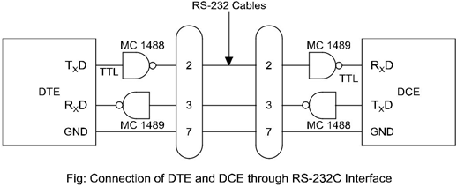

Slide 35
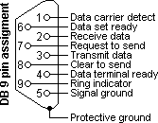
The pins abbreviations are (numbers in parentheses are the 25D pin numbers.
1. CD (8)
2. RD (Rx) (3)
3. TD (Tx) (2)
4. DTR (20)
5. SG (Ground) (7)
6. DSR (6)
7. RTS (4)
8. CTS (5)
9. RI (22)

Slide 36
Data Terminal Ready (DTR):
After the terminal power is turned on and terminal runs any self checks, it asserts data terminal ready (DTR’) signal to tell the modem that it is ready.
Data Set Ready (DSR):
When the MODEM is powered up and ready to transmit or receive data, it will assert data set ready (DSR’) to the terminal. Under manual control or terminal control, modem then dials up the computer. If the computer is available, it will send back a specified tone.
Request to send (RTS):
When a terminal has a character ready to send, it will assert a request-to-send (RTS’) signal to the modem.
Data Carrier Detect (DCD):
The modem will then assert its data-carrier-detect (DCD’) signal to the terminal to indicate that it has established connection with the computer.

Slide 37
Clear to send (CTS):
When the modem is fully ready to receive data, it asserts the clear-to-send (CTS’) signal back to the terminal.
Ring indicator (RI):
It indicates that a ring has occurred at modem. Deactivating DTR or DSR breaks the connection but RI works independently of DTR i.e. a modem may activate RI signal even if DTR is not active.
Transmitted Data (TxD):
The terminal then sends serial data characters to the modem.
Received Data (RxD):
Modem will receive data from terminal through this line.
Data Signal Rate Detect (DSRD):
It is used for switching different baud rate.

Slide 39
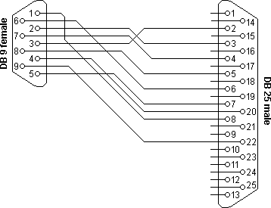
9D to 25D Conversion

Slide 40
RS 449 Interface
Is able to send data at high Speed without stray noise causing interference is to use a differential form of signaling.
As the RS449 receivers use a differential input, and they are not referenced to ground, any noise that is picked up does not affect the input.
This means that higher levels of noise can be tolerated without any degradation to the performance to the data communications system.
For the RS449 interface, ten additional circuits functions have been provided when compared to RS232.
In addition to this the RS449 interface requires the use of 37 way D-type connectors and 9 way D-type connectors, the latter being necessary when use is made of the secondary channel interchange circuits.

